Slide 1
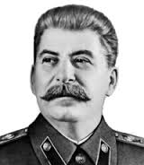
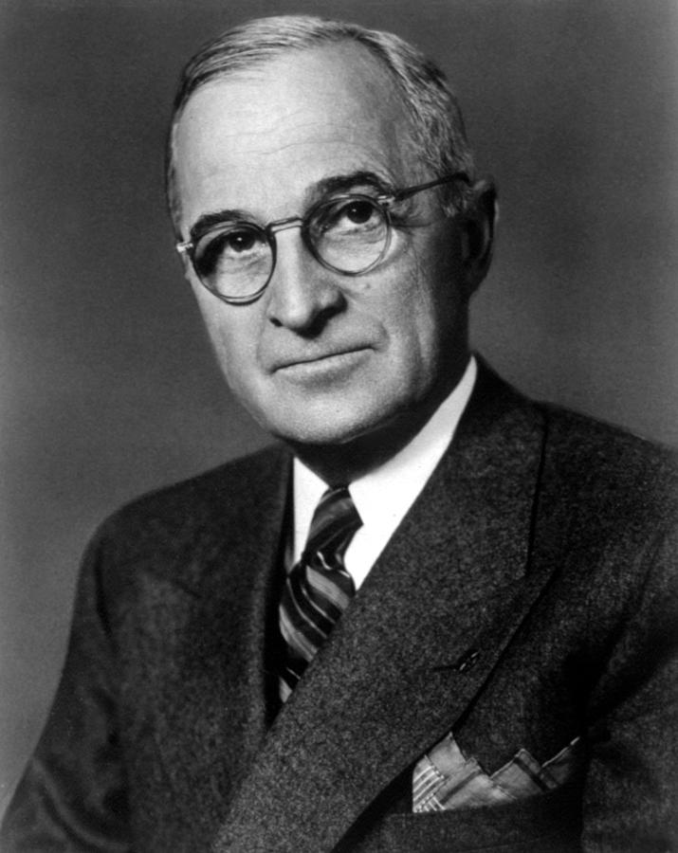
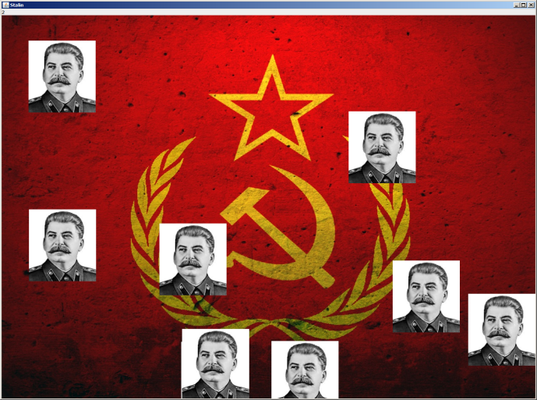
Communist Hunt
Cooper Chia, Griffin Craft, Noah Weiss
Computer Science, Roosevelt High School, Seattle, WA
Game Description
Code Structure and Data Structure
Challenges
Communist Hunt is based on the original game of Duck Hunt. The player is sent by Harry Truman to protect his or her country by defeating an army of Joseph Stalin clones. The clones fly across the screen, and several clones may be on the screen at once. Once the player kills a certain amount of clones, the game ends. The total duration of the game, as well as the player’s accuracy, are then displayed.
Our game currently contains four classes. Background.java is our client class that creates a new game as well as the JFrame for the game. Game.java is the class that does most of the work. This class deals with the spawning of the Stalin clones, the AI movements of the clones, and the hit detection when the mouse is clicked. The Stalin.java class constructs the individual Stalin objects, and the Menu.java class creates the menu image before and after the game. Aside from these four classes, our game extends/implements the following default classes: JPanel, ActionListener, and MouseListener.
One of the big challenges we had was deciding how to structure our code. At first, we tried to use too many classes, and had a hard time using them all in conjunction with each other. We also spent a lot of time dealing with the AI movements of the Stalin clones.
Background.java
Background.java
Game.java
Menu.java
JPanel, ActionListener, MouseListener
Stalin.java
What’s Next?
We feel there are certain aspects of the game that can be improved over time. Some ideas we had included: having the ability to choose between different characters, quality sound effects, and adding different modes to our game. These are some of the things we can work on in the future if we choose to continue this project. We have learned a lot from creating this game, and we can use these skills to create different games as well.
Target Users
Our target users include anyone who wants to sit down for a little bit and play a simple, yet engaging game. The game does not last long, but the player must devote considerable focus to the game during that time in order to get a good score.
In addition, our game is very much geared towards people who love simple shooter games. Communist hunt can be played casually, but can also be competitive. Players can challenge friends to beat their time or accuracy.
Work Process
Once we decided to create this game, the first thing we did was go through a tutorial of how to make the game “Pong” because the basic principles of both games are similar. After that, we made our code structure plan and began to write the game code, with the simpler parts coming first. One area we struggled with at first was using basic graphics. We resorted to the textbook and test code a lot, which slowed our game development. When we reached our first evaluation, we had been working on six classes, and we thought we were close to finishing the rough state of the game. However, we realized that we had too many classes, which made it difficult and confusing to connect all of the pieces. Eventually, we decided that we didn’t need several of the classes. We ended up removing the class we spent the most time on, and simply implemented an interface to solve the problem. After we completed the very basic state of the game, we started to work on adding simple features to improve it, such as a score counter and a game menu.
Project Tagline
“A game for true patriots”

